Slide 1

BOF End Point Carbon Control
AIST-OSTC Study Tour 2019
Notes:
Good afternoon and good morning everyone and welcome to the Q1 results presentation.
Today I am joined by…

Slide 2
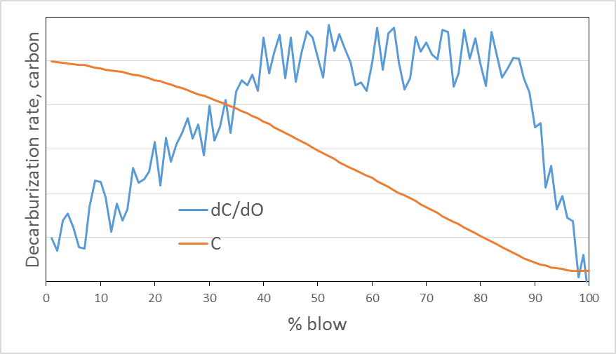
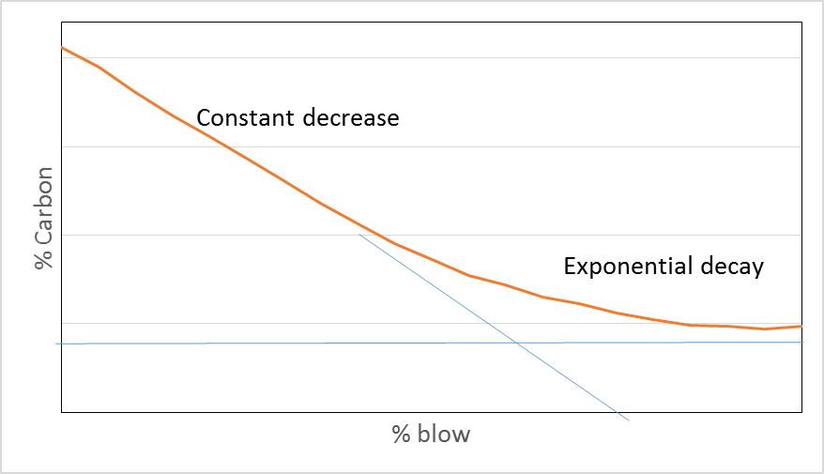
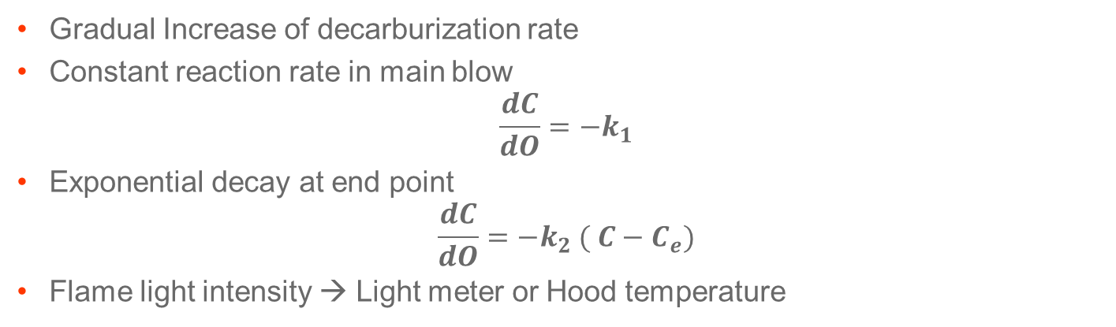
BOF Carbon End Point
Carbon shift
Gradual Increase of decarburization rate
Constant reaction rate in main blow
$$\frac{dC}{dO}=−k_{1}$$
Exponential decay at end point
$$\frac{dC}{dO}={−k}_{2} ( C−C_{e})$$
Flame light intensity → Light meter or Hood temperature
© ArcelorMittal 2019 - All rights reserved for all countries
Cannot be disclosed, used, or reproduced without prior written specific authorization by ArcelorMittal
CONFIDENTIAL - Privileged Information - ArcelorMittal proprietary information

Slide 3
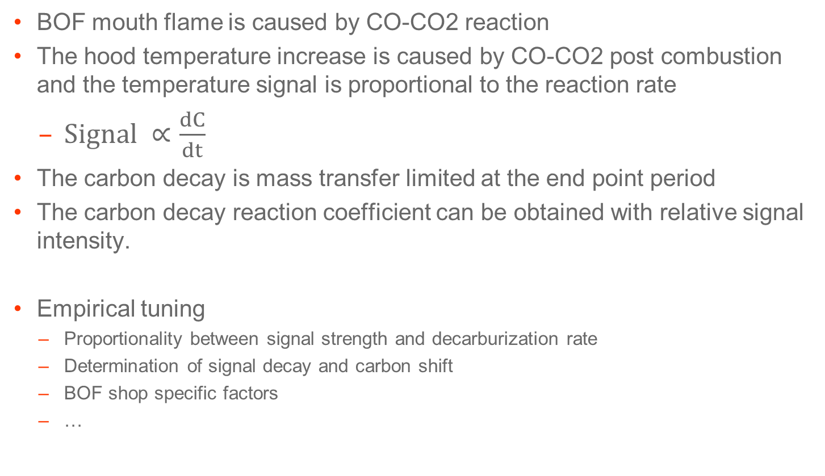
Model Assumptions
BOF mouth flame is caused by CO-CO2 reaction
The hood temperature increase is caused by CO-CO2 post combustion and the temperature signal is proportional to the reaction rate
  $Signal ∝\frac{dC}{dt}$
The carbon decay is mass transfer limited at the end point period
The carbon decay reaction coefficient can be obtained with relative signal intensity.
Empirical tuning
  Proportionality between signal strength and decarburization rate
  Determination of signal decay and carbon shift
  BOF shop specific factors
  …
© ArcelorMittal 2019 - All rights reserved for all countries
Cannot be disclosed, used, or reproduced without prior written specific authorization by ArcelorMittal
CONFIDENTIAL - Privileged Information - ArcelorMittal proprietary information

Slide 4
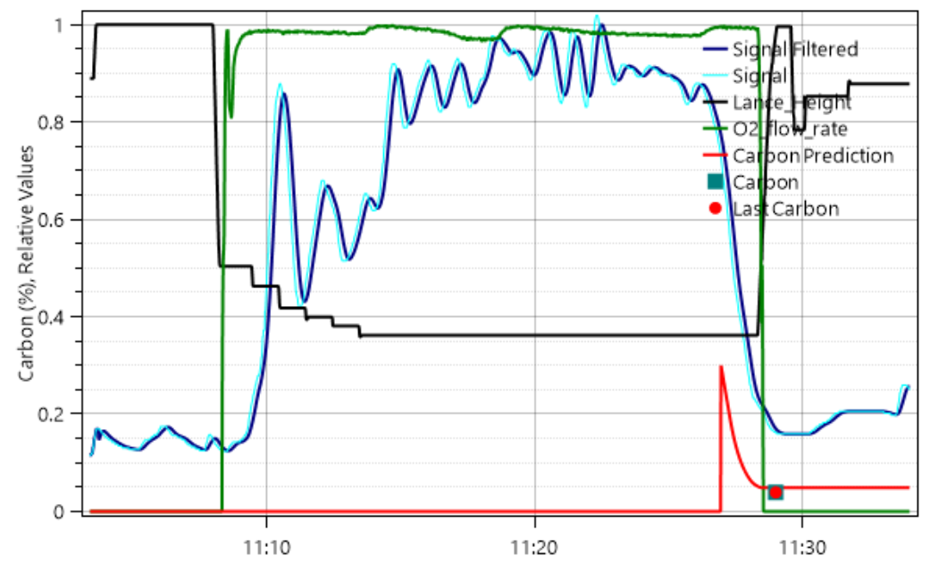
Example
© ArcelorMittal 2019 - All rights reserved for all countries
Cannot be disclosed, used, or reproduced without prior written specific authorization by ArcelorMittal
CONFIDENTIAL - Privileged Information - ArcelorMittal proprietary information

Slide 5
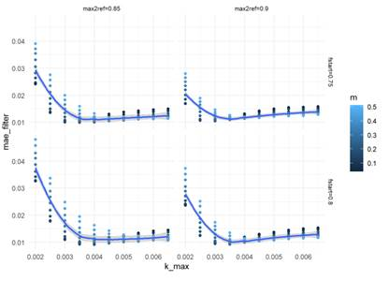
Parameter Tuning and Controls
Offline simulation capability with past production
  Grid search on tuning parameters
  Other efficient optimization technique can be used
Objective was to minimize the Mean Absolute Error
Control rules
  Customize control rules with other criteria such as deviation from charge calculation or offgas analysis if available.
© ArcelorMittal 2019 - All rights reserved for all countries
Cannot be disclosed, used, or reproduced without prior written specific authorization by ArcelorMittal
CONFIDENTIAL - Privileged Information - ArcelorMittal proprietary information

