Slide 1
Waste and Reverts Management
October 2019

Slide 2
What we’ll cover
Overview of the Scunthorpe integrated works
BOF Plant Main Wastes & Reverts
  Wastes
  Slags
  Dusts
Continual improvement
Questions
Notes:
Today I intend to cover, briefly, how we manage wastes and reverts at our BOF Plant in Scunthorpe.
I shall start by giving a short overview of the Scunthorpe works, which has a great deal of history and was operated in times when the steel industry and environmental regulations and waste management practices were certainly not what they are today.

Slide 3
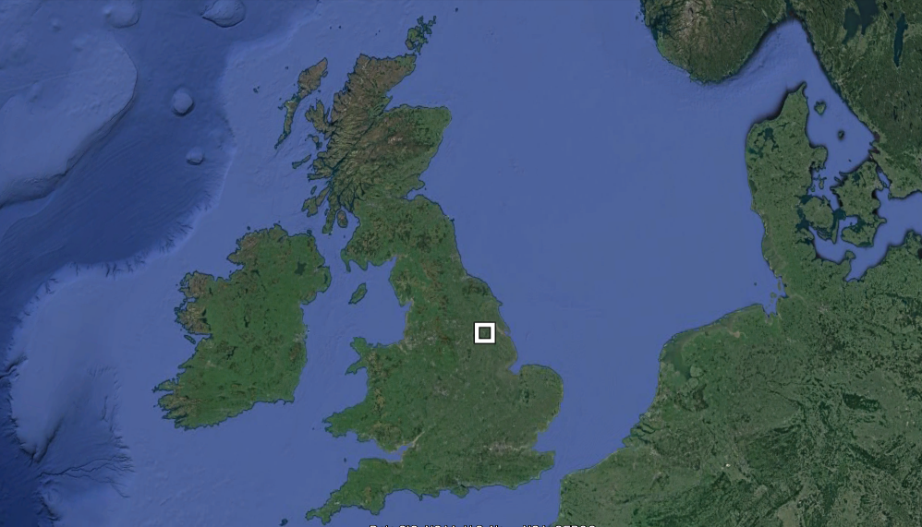
Overview of the Scunthorpe integrated works
Notes:
British Steel’s Scunthorpe works is located in North Lincolnshire, in England’s East Midlands. The works is situated on extensive deposits of low-grade ironstone, which were the original reason for ironmaking establishing itself in the area. The works is located around 10 miles inland from the Humber Estuary, which is home to one of England’s largest port complexes.

Slide 4
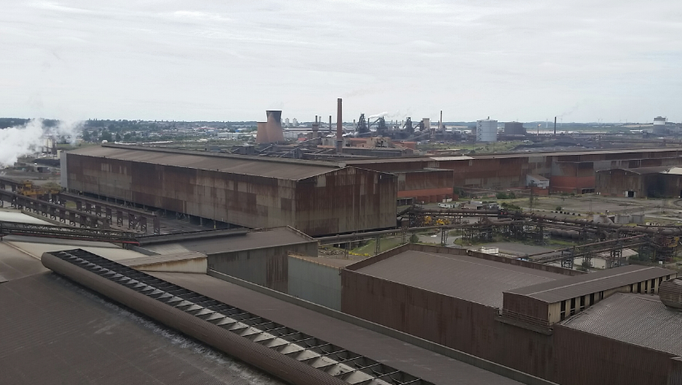
Overview of the
Scunthorpe integrated works
Commercial iron ore exploitation began in
North Lincolnshire, England, in 1859
First blast furnace at Scunthorpe opened
in 1864
Extensive quarrying of ironstone, leading to
three major integrated works developing,
which were nationalised into the British
Steel Corporation in 1967
Privatised in 1988; merged to form Corus in 1999, later became part of Tata Steel Europe
TSE sold Scunthorpe, along with the rest of its European Long Products business, to Greybull Capital in 2016
New business, British Steel Ltd, now operates Scunthorpe’s four blast furnaces, coke ovens, BOF plant, concast plant, wire rod and rail and section mills
Site covers over 800 hectares and includes three landfill sites
Notes:
Scunthorpe was a farming area until the late 19th century, when the local ironstone began to be exploited at an industrial scale. The first local blast furnace opened in 1864, and over time a series of local iron and steelmakers established themselves in the area. When the British government nationalised the steel industry in 1967, three large integrated works in the town joined the then British Steel Corporation.
Over time, the steelworks were rationalised. In 1988 the British Steel Corporation was privatised and in 1999 merged to become Corus. Corus was bought by Tata Steel in 2007.
In 2016 our new company, British Steel Ltd, was formed when Tata’s Long Products Europe division was sold. The Scunthorpe Integrated Iron & Steelworks is British Steel’s only integrated works; we also own a number of mills elsewhere in the UK and Europe.
Elsewhere on the works, we operate coke ovens, four blast furnaces and two mills.

Slide 5
BOF Plant Main Wastes & Reverts
Wastes |  | Reverts
Packaging | Plastic | Slag | Vessel Slag
 | Cardboard |  | Slopping/Debris
 | Wood |  | Desulph Skim
 | Metal | Dust | VDG Dust
 | Glass |  | LAF Dust
 | Batteries |  | Desulph Dust
 | Aerosols |  | Secondary extraction dust
Refractories | Vessel Bricks |  | General Cleaning Dust
 | Ladle Bricks |  | Lime Dust
 | Concrete & Spray | Water Treatment | Vessel Coolant Slurry
Others | Oils & Greases |  | Precipitator Slurry
 | Filters | Metal | Ladle / Tundish returns
 | Cable |  | Caster Scale
 | General |  | Crops
Notes:
This table show the main wastes and revert materials generated at our BOF Plant. I have a single slide on how we manage wastes but have a little more detail on Steel Slag, Dusts & Slurries. All metal is recycled internally in the plant as a replacement for purchased scrap & as such I haven’t made any further reference to it.

Slide 6
Wastes
Segregation
(Cost - ££)
External Sale
(Revenue - ££)
Plastic
Cardboard
Wood
Batteries
Aerosols
Metal
Positives
Minimised waste to landfill
Good sources in to the recycling network
Been able to mothball internal landfill sites
Truck
Packaging
General
Waste
External Sale
(Revenue - ££)
Oils
Greases
Cables
Plastic Wrap
Contaminated
Wood, cardboard etc.
Filters
Others
Truck
Improvement Focus
Reduce level of packaging on incoming materials
Improve segregation at source
Reduce Segregation costs
Increase revenues from waste
Improved segregation of waste oils to increase sales revenue
BOF
Refractory
External Sale
(Revenue - ££)
Vessel Bricks
Ladle Bricks
Truck
Disposal
(Cost - ££)
Concrete & Spray
Notes:
At British Steel Scunthorpe we segregate the key recyclable materials as detailed which are sold in to the waste market. Any residual waste is sent to a reprocessor (at cost) where it is turned in to a solid recovered fuel and supplied to cement kilns.
By forming partnerships with market leading waste management companies we have managed to reduced landfill disposal to just 272t in 2018.
This said we know we can still do much more by focussing on waste minimisation (reduce packaging etc.) and improving our internal segregation at source and hence further reducing waste management costs.
Additionally we are relentless in our efforts to increase revenues from the waste materials we generate (this month increased average oil disposal revenues by >30% through changing supplier & better segregation).

Slide 7
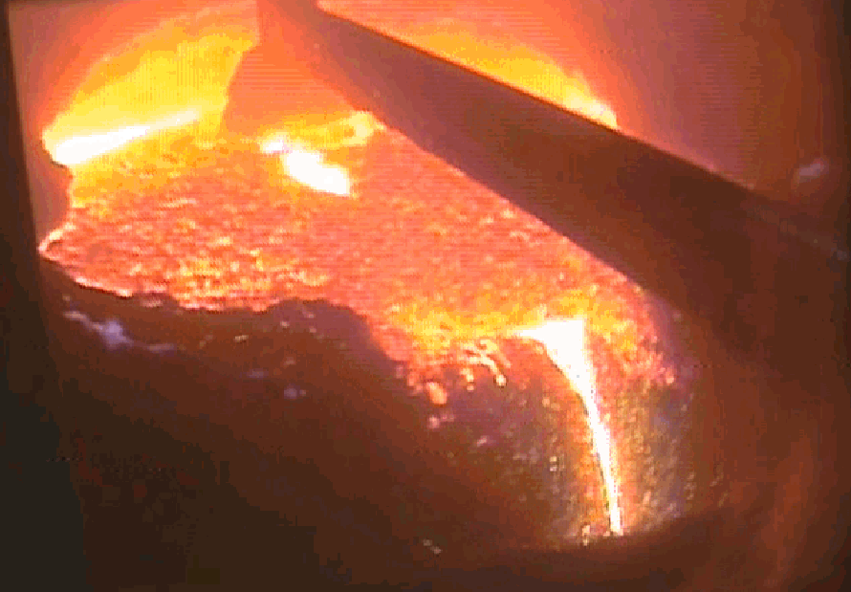
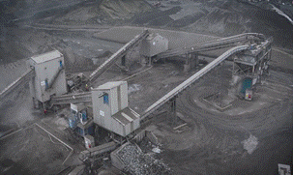
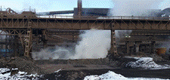
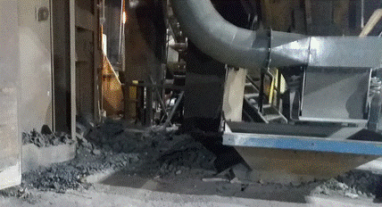
Slag
Desulph Skim
Glass used to improve desulph yield
Metal recovery consumption restricted due to Sulphur
Slag fines restricted to BF due to Alkalines
Arising rate greater than consumption
External Sale
Slag
Convertor slag
Metal
100% Metal Recycled
& 100% Slag Sold
BOF
Debris
100% Metal Recycled
& 100% Slag Sold
Notes:
Desulph Skim slag = c20kg/t hot metal this is removed from plant whilst hot and sent to the metal recovery plant to be weathered prior to processing to recover the iron.
Vessel slag = c80kg/t Liquid Steel is poured from slag pots in to pit adjacent to the BOF plant and is water cooled. When cool this material is taken to the metal recovery plant where the metal is mechanically removed and returned to the scrap bay and the demetalled slag is sent to a 3rd party vendor.
Vessel slag is crushed, sized and left to ‘weather’ by the 3rd party vendor to allow free lime to hydrate. This material is coated with bitumen and used for road surfacing.

Slide 8
Dust
Two main types:
We XRFed and XRDed all our steel dusts to establish their value as raw materials
Fume extraction dusts | General cleaning dusts
“Secondary Vent” dust from vessel fume (60-70% Fe₂O₃ | Floor dusts (mixed sweepings and vacuumed dust) 30% Fe₂O₃, 30% lime, some alloys)
Desulphurisation dust (60-70% Fe₂O₃) | Lime reception bunkers (99% lime)
LAF dust – High Fe and Ca | Crane dusts (10-60% Fe₂O₃)
Leaded steel dust (70% PbO)
Material handling system dusts (from conveyors etc.) – high free lime content | Vessel seal pots and elbows (80% Fe₂O₃)
Settled iron solids from BOF water treatment plant
Wet BOF slurry
Notes:
Within the BOF we produce a variety of dusts that are extracted from our gas cleaning systems in solid form. Some of these are mainly lime – others are more metallic.
We aim to send the maximum amount of high lime dusts possible back to our sinter plant, as a lime replacement, and are only constrained by alloy contamination (zinc, lead, cadmium etc.). We sample and analyse our dusts regularly to establish their contents using XRF. The first time we did this we sent our samples for XRD, which allows us to know what form the alloy is present in. This helps ensure we don’t send anything to our sinter plant that would cause them problems.

Slide 9
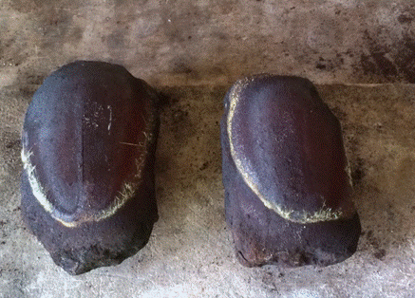
Dust
Two main types:
Fume extraction dusts | General cleaning dusts
Blended with dewatered BOF gas cleaning slurry to make metallic briquettes (57% Fe) and a saleable blended iron cake for cement industry High Pb dust sold to lead smelter | Blended with high Fe solids from water treatment plant to control dust, and moved to Ore Processing Plant for sinter make
Wet BOF slurry
Dewatered using a press. Solids used for briquettes & a blended iron cake for cement industry, alongside Blast Furnace Hydrocyclone Overflow Cake.
Notes:
Briquettes flux early in the blow. However, due to their cooling effect using briquettes restricts the ability to reduce hot metal and increase scrap charge. For every 1 tonne of briquettes we reduce scrap charge by 2 tonnes.
Dusts that are high in alloys are sold into other non-ferrous processes.
Where we have dusts that are mixtures of metallics and lime, we seek to blend these to a specification suitable for our sinter plant.
The main problem we encounter is revert streams becoming contaminated with non-dusts within the BOF plant, which means we have to double-handle material.

Slide 10
Continual Improvement
Short term
  Improved internal education & understanding of the value of “waste” as revert material
  Drive to reduce contamination of revert streams
  Improved fume extraction to collect more segregated dusts
  Aspiring to reclassify metallic briquettes as a by-product.
Long Term / Investment Opportunities
  Micro pelletiser to ease recovery through sinter plant
  Lime fines prevention/capture
  Revert washing (removes chlorides)
Alternative technologies
  We are researching a range of dezincing technologies that would enable us to maximise the recovery of our blast furnace and steelmaking reverts via our sinter plant (e.g. high-temperature thermal processes)
Notes:
Short term
Refer to slide – about improving quality of reverts.
Long term
Micropelletising dusts allows them to be handled more easily and reduces the risk of dust lift-off from our site. They are a consistent product which helps the sinter plant better plan their ore beds. Micropellets are also much less likely to be lost from the sinter strand via their gas collection system than fine dusts.
We are exploring a range of alternative material handling techniques that could allow us to reduce the proportion of fine (<12mm) lime particles in our raw material stream. Simultaneously, we are looking at options to capture lime fines if it is not possible to eliminate them. These can then be utilised as a lime replacement elsewhere in the integrated works.
Revert washing removes chloride & hence reduces dioxin levels to meet legal standards.
Alternative technologies
If pressed, explain we have been looking at kilns/rotary hearth options but this is preliminary work.

