Slide 1
Dillinger – BOF Steelmaking
Automation & environmental aspects
Dominik Schöne

Slide 2
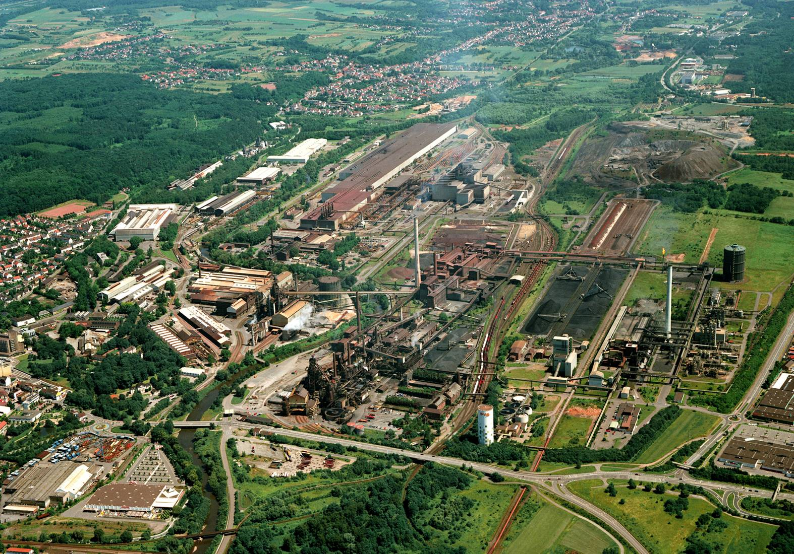
Dillinger Hütte – an integrated metallurgical plant
Rolling mill
Steel plant
Blast furnace
Coking plant

Slide 3
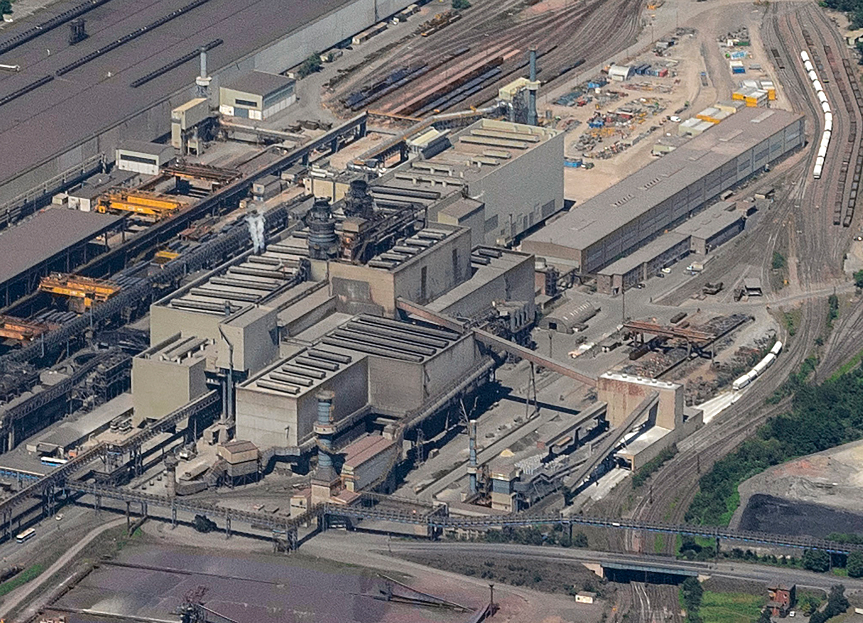
Dillinger Hütte – Steel plant

Slide 4
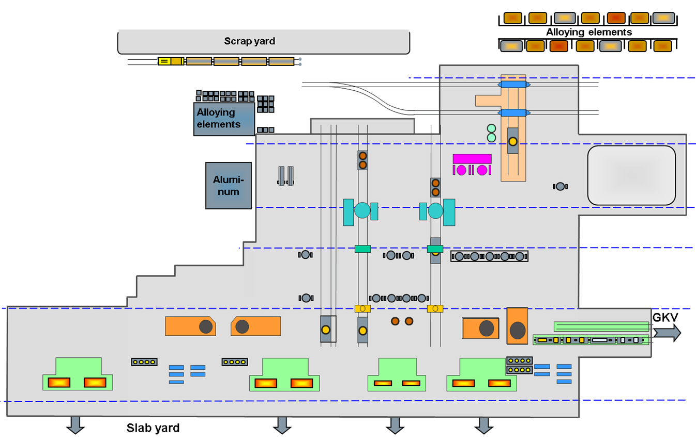
Layout of the steel plant and production facilities
1
Hot metal Δ S
Δ P
Δ C
(rough adjustment
of temperature)
steel Δ S
Δ N
Δ H
(Δ C)
cleanliness
inclusion modification
cleanliness
prevention of resulphurization
minimization of segregation
prevention of surface defects
2
3
3
4
4
7
5
5
6
11
10
9
8
12
Hot Metal
1 Hot metal re-ladling and
desulphurization facility
2 Scimming facility 1 + 2
Converter Process
3 Top blowing BOF with bottom stirring 1 + 2
Secondary Metallurgy
4 Ladle stirring stand / alloying stand
5 Gas injection stand
6 Tank degasser VD1/4
7 Tank degasser VD2/3
Casting
8 Continuous caster No. 4
9 Continuous caster No. 3
10 Continuous caster No. 5
11 Continuous caster No. 6
12 Ingot casting stand

Slide 5
Content
Environmental aspects (Reducing Dust Emissions)
Steelmaking Automation (Sub Lances, Off-gas analysis, Slag carry over control, Ladle level control)

Slide 6
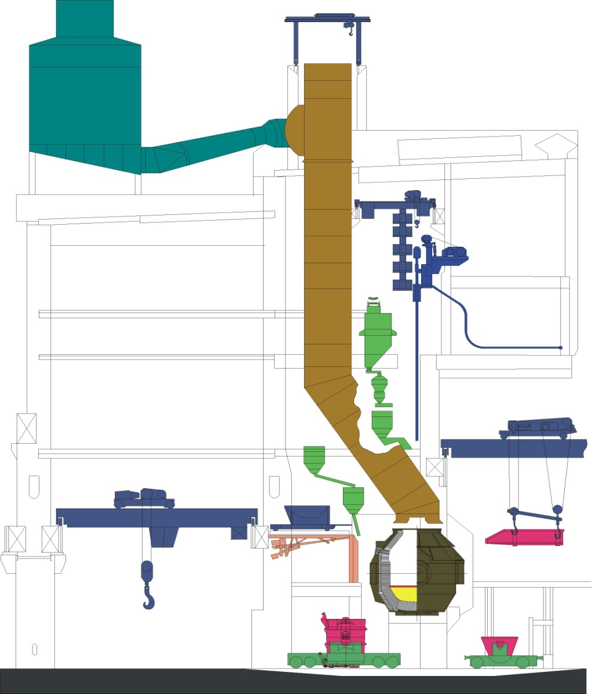
BOF – primary dedusting system
Off gas analysis
Tapping weight (t) 195
Volume (m³) 160
Specific volume (m³/t) 0,82
Bath depth (m) 1,65
6-hole lance (°) 17,5
Bottom porous plugs 6
max. 5 m³ i.N./min
Electric filter
2 lance systems for each BOF
Venturi system (water and steam flow)
Primary dedusting system (Fe-oxide+lime dust, post-combustion CO to CO₂ by surrounding air → steam generation in the boiler system)
BOF vessel ([C]-oxidation to CO/CO₂); reducing dust emissions by adapting O₂-flow rate
Surrounding air (open system)

Slide 7
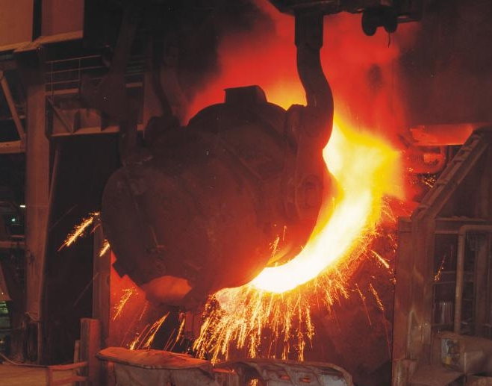
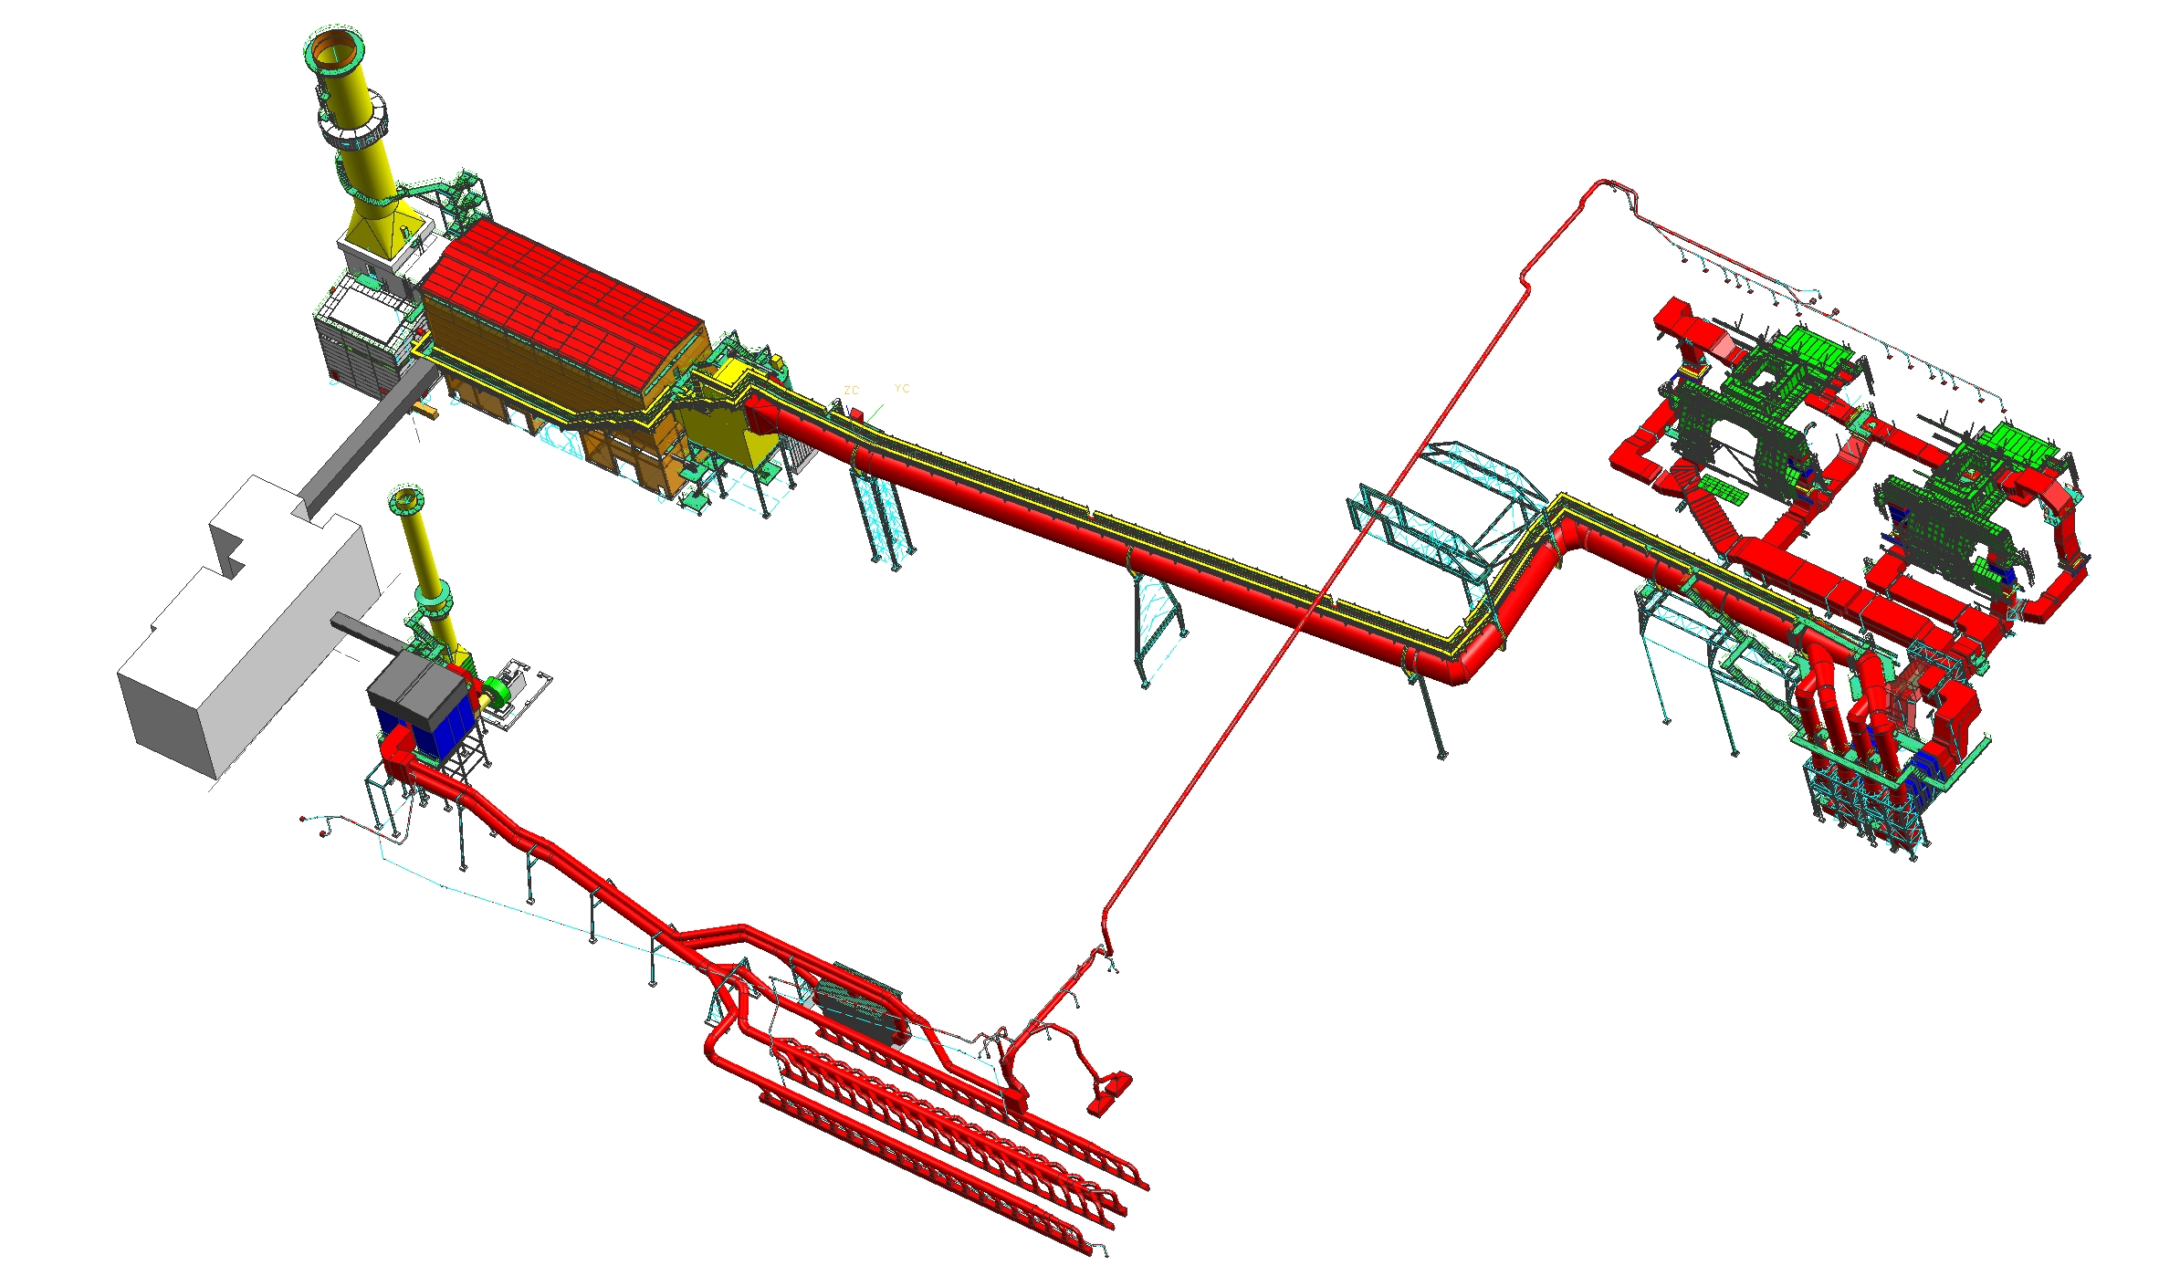
BOF – secondary dedusting system (SVAI)
BOF1&2 (Charging, tapping; 2010)
Air flow: 1.600.000 m3/h
Power ID fan: 2x2.500 kW
8 heat exchanger
Dust: < 10 mg/Nm3
Filter house
Lime unloading and alloying bins (2009)
Air flow: 340.000 m3/h
Power ID fan: 1.000 kW
Dust: < 10 mg/Nm3
+ secondary dedusting for hot metal reladling (430.000 Nm3/h) and deslagging

Slide 8
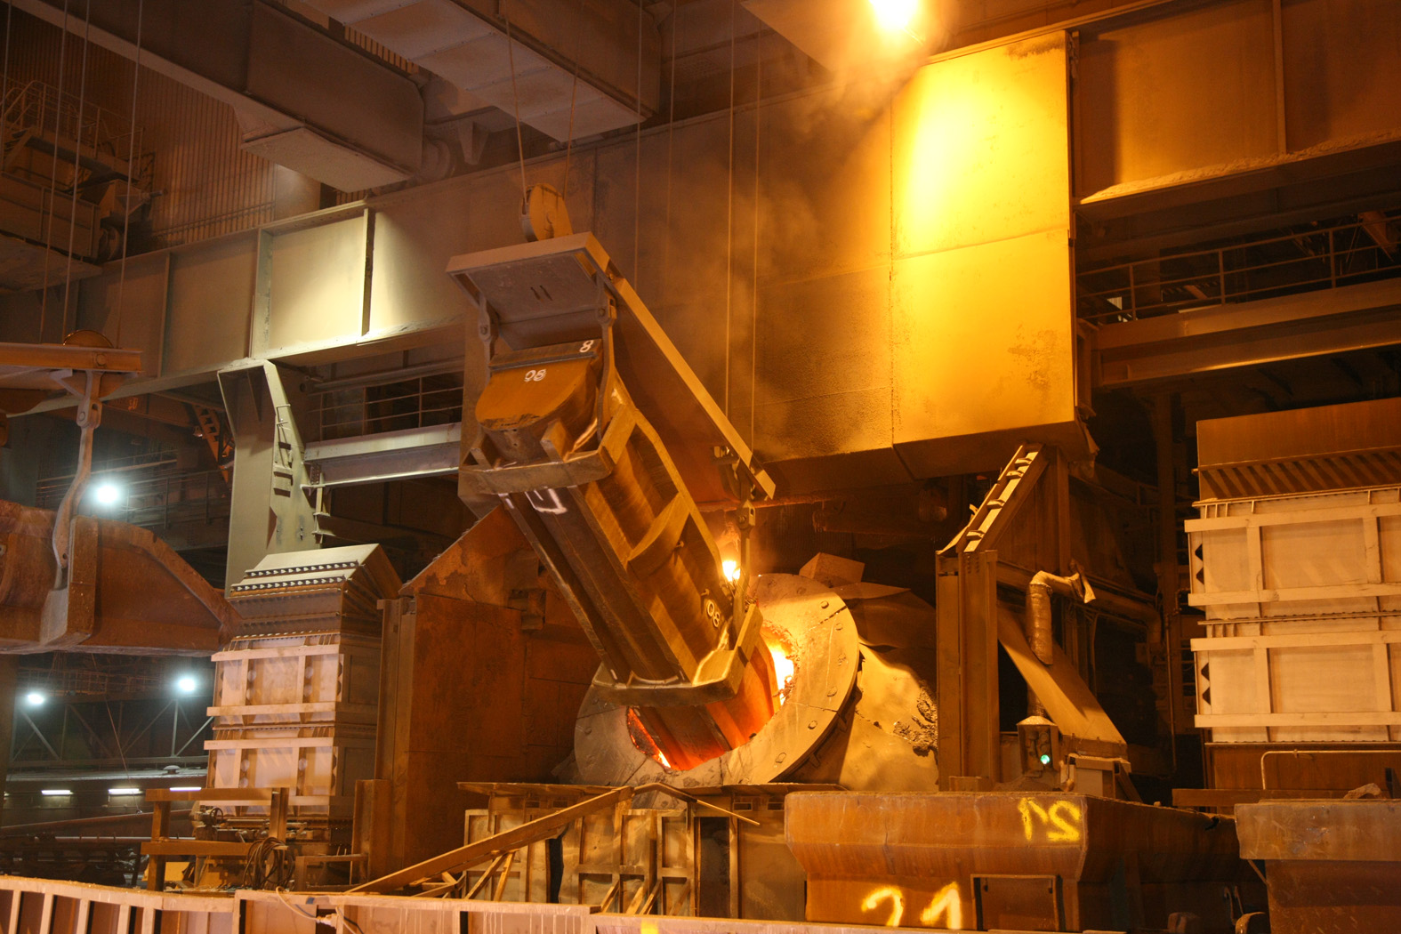
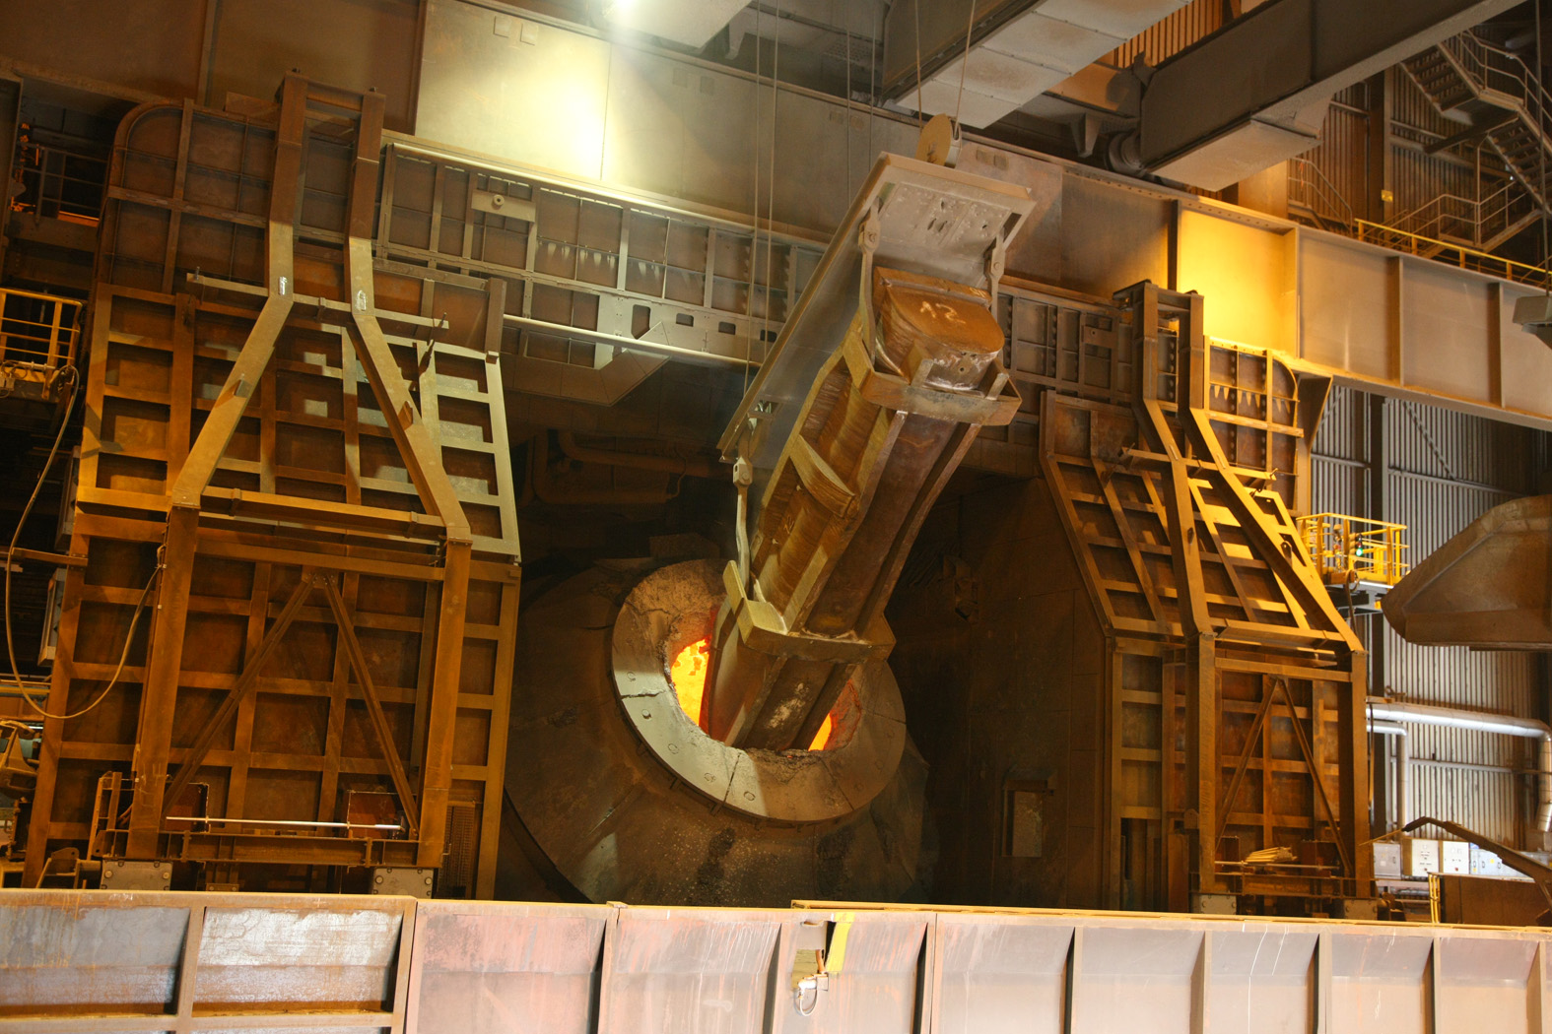
Charging of scrap
With secondary dedusting
Without secondary dedusting

Slide 9
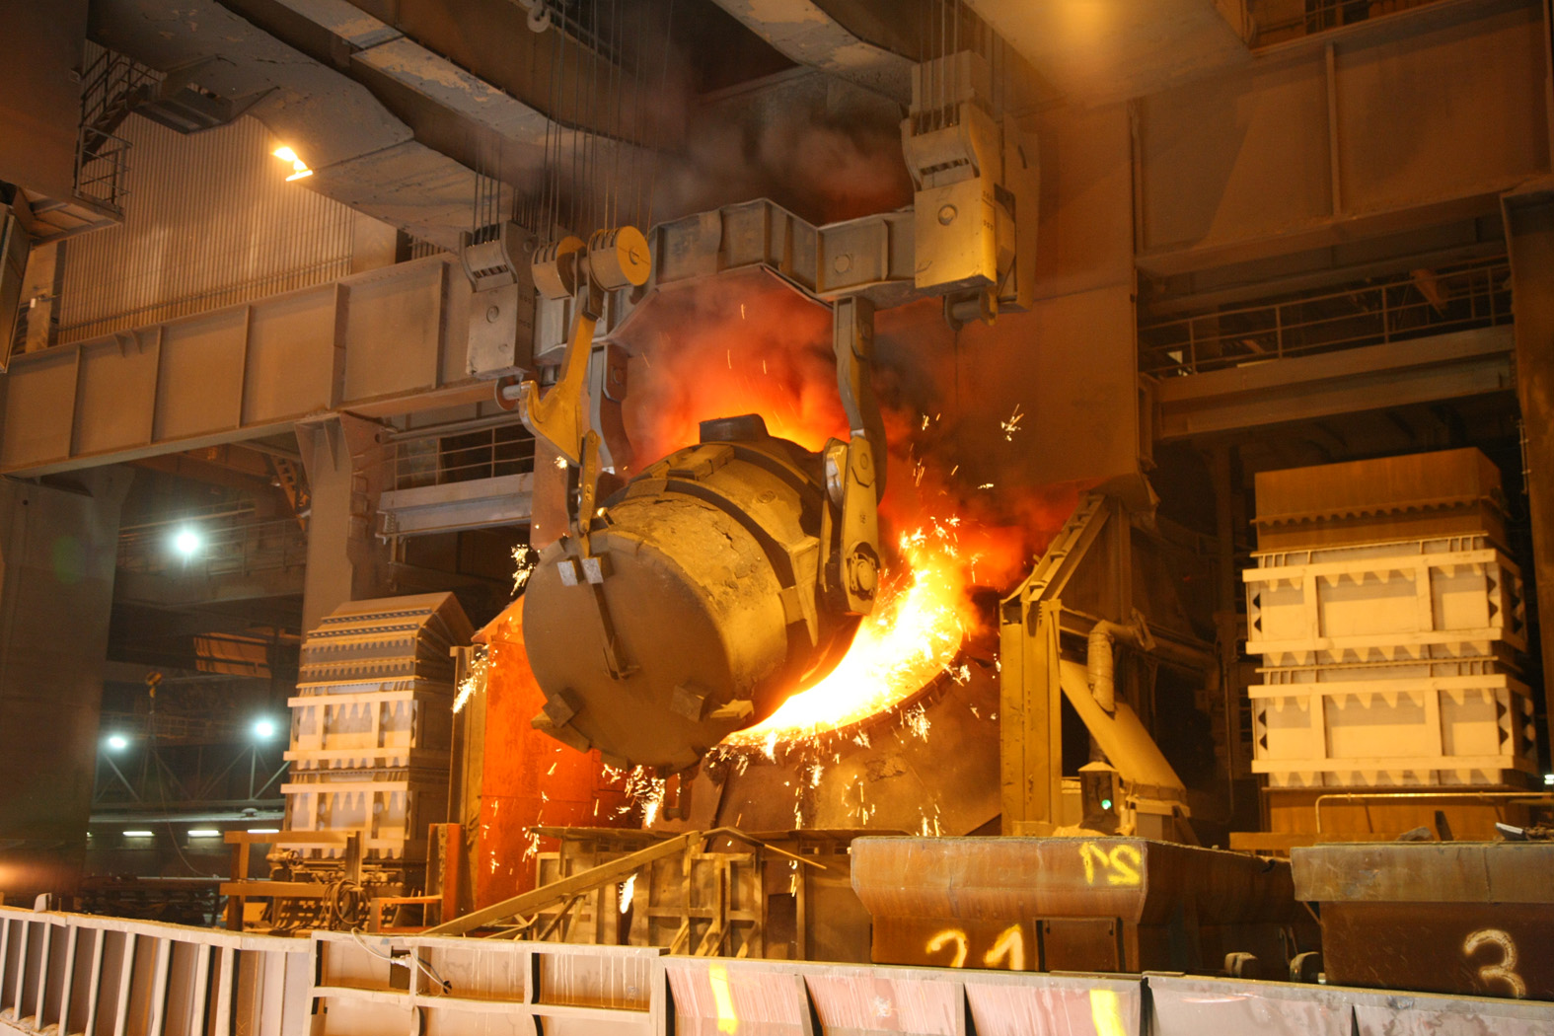
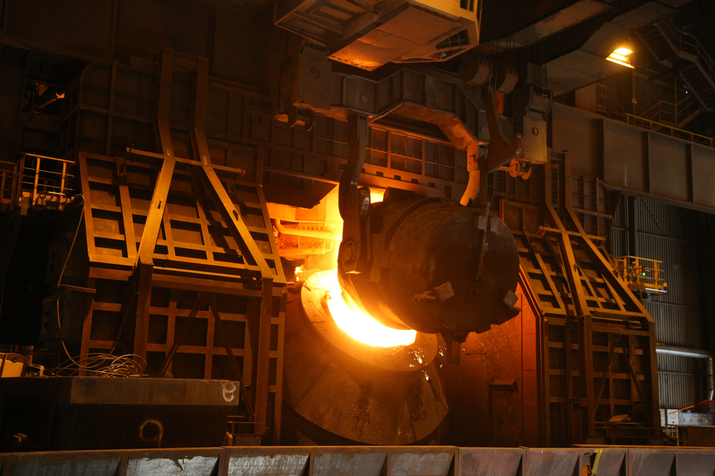
Charging of hot metal
With secondary dedusting
Without secondary dedusting

Slide 10
Automation: Control of BOF process
Online heat and time scheduler
Model for heat and mass balances
Lime calculation model
End of blow detection by off gas analysis
Temperature model (BOF and ladle)
Dynamic control of lance height
Bath level control by radar (min. 1 per shift)
Temperature & sample manipulator (after blow; under construction)
Charging
Slagmon system for slag detection during tapping (possible: automatic end of tapping)
Model for ladle desoxidation, lime and alloying
Ladle level control by laser measurement (VD, 1 per heat)
Dynamic control of bottom stirring

Slide 11
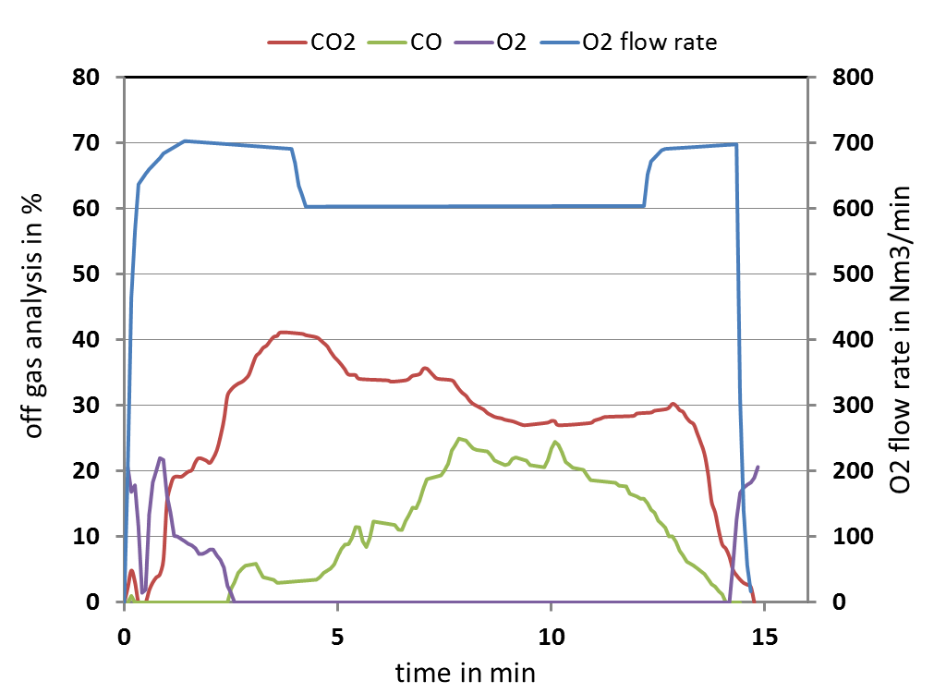
Off gas analysis on the roof
End of blow if [C]-content is reduced to nearly 0. → EoB criteria: combination of t, %CO, %CO₂, %O₂; no sublance.
Charging

Slide 12
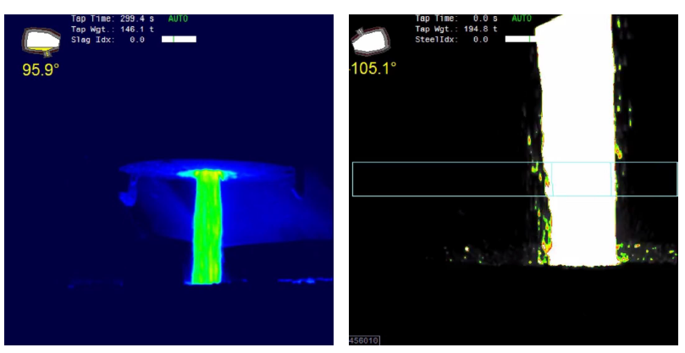
Slag detection by Slagmon system (Primetals)
If slag is detected by IR during tapping: slag alarm and tilting of the vessel (manually); automatic end of tapping possible, but not in operation
Charging
a) Tapping of steel
b) Discharging of slag

Slide 13
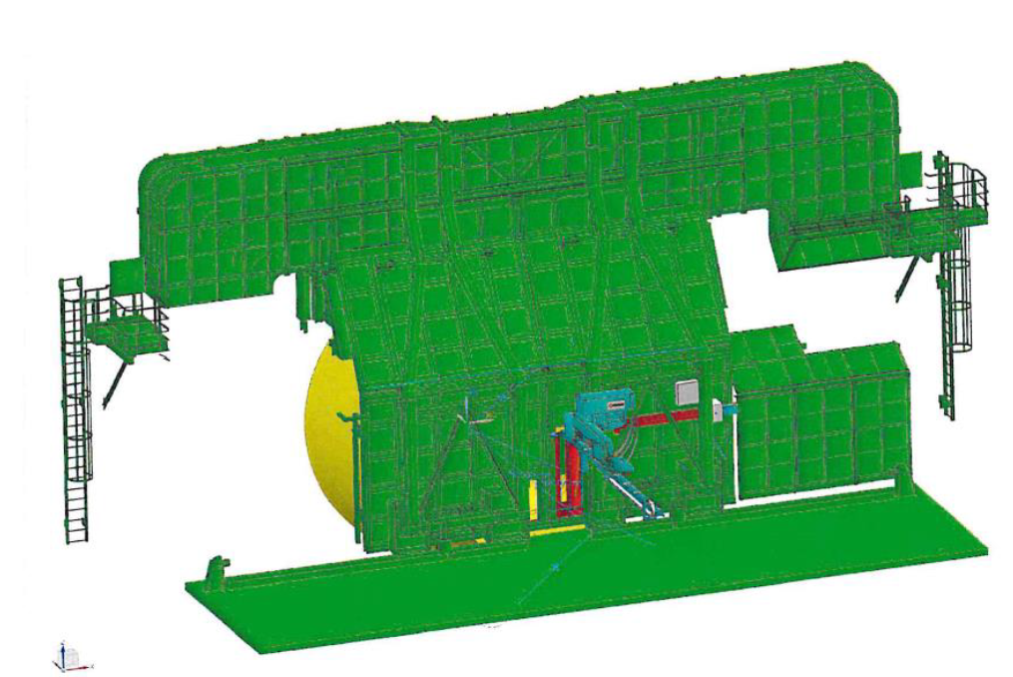
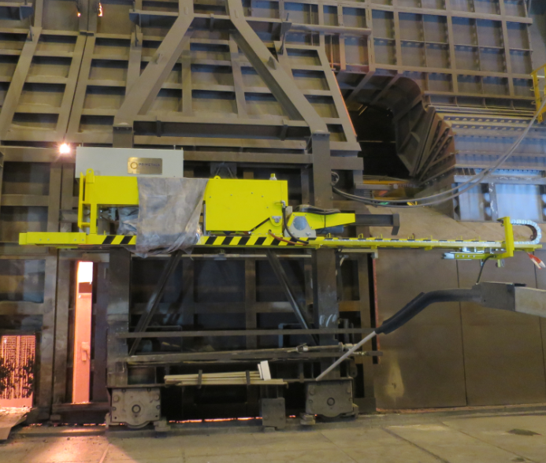
Temperature and sample manipulator (Primetals)
Already installed at BOF#2 (Sep 2019), but not yet in operation.
Charging

