Slide 1
BOF Endpoint Control
AIST OSTC Study Tour 2019
October 2019
Chad Cathcart, P. Eng.

Slide 2
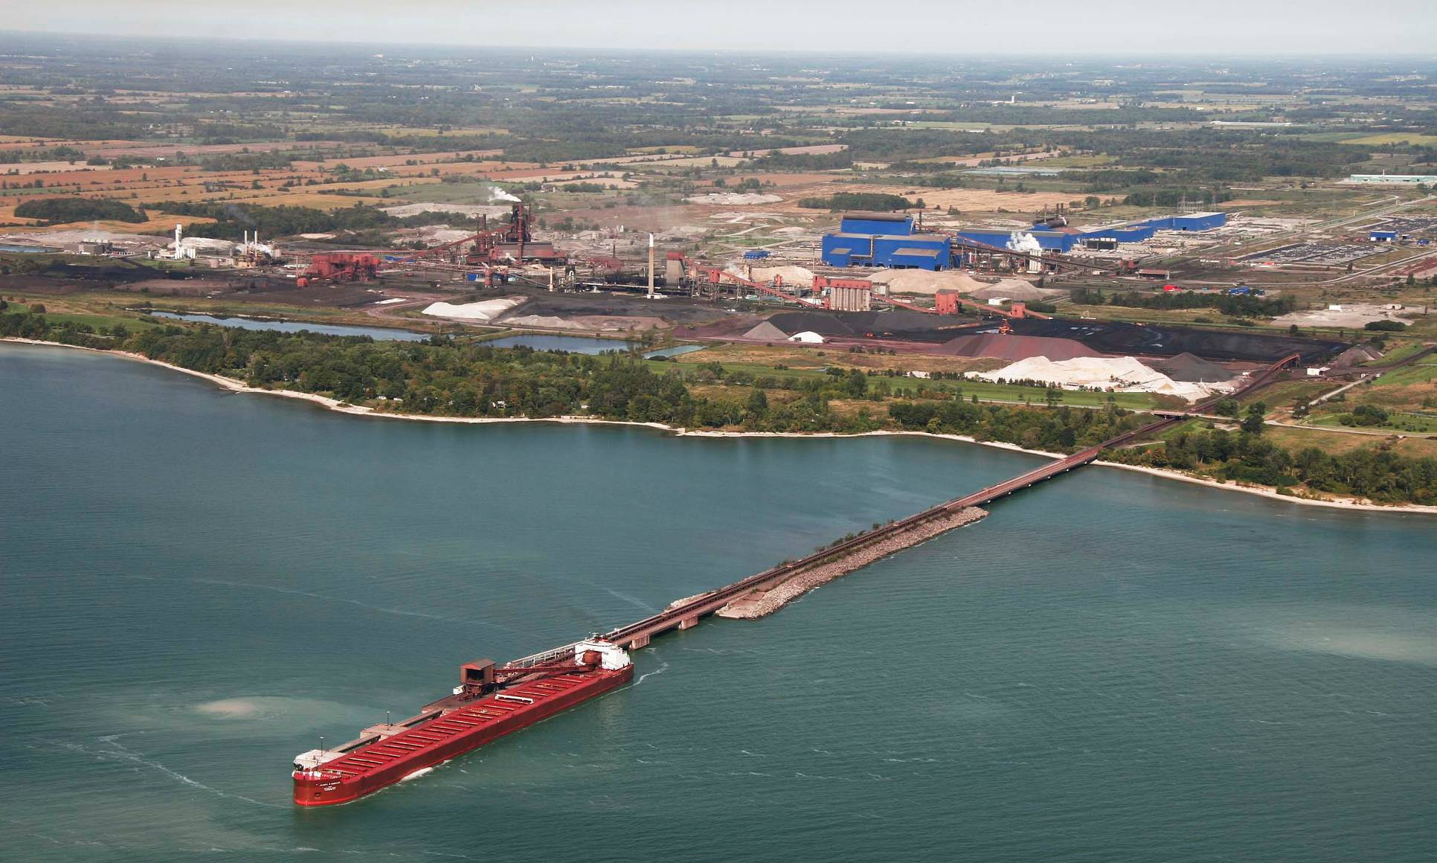
Stelco Steelmaking Overview
PICKLING
STEELMAKING
HOT STRIP MILL
IRONMAKING
MAINTENANCE
CENTRAL
BOILER
STATION
COKEMAKING
Ground breaking in 1974; start-up in 1980
Located on the north shore of Lake Erie in Ontario
6,600 acres (2,670 hectares) of Zoned Industrial Land
2,200 acres (890 hectares) steel mill
¾ mile (1.2 kilometre) dock
Access by Road, Rail & Water

Slide 3
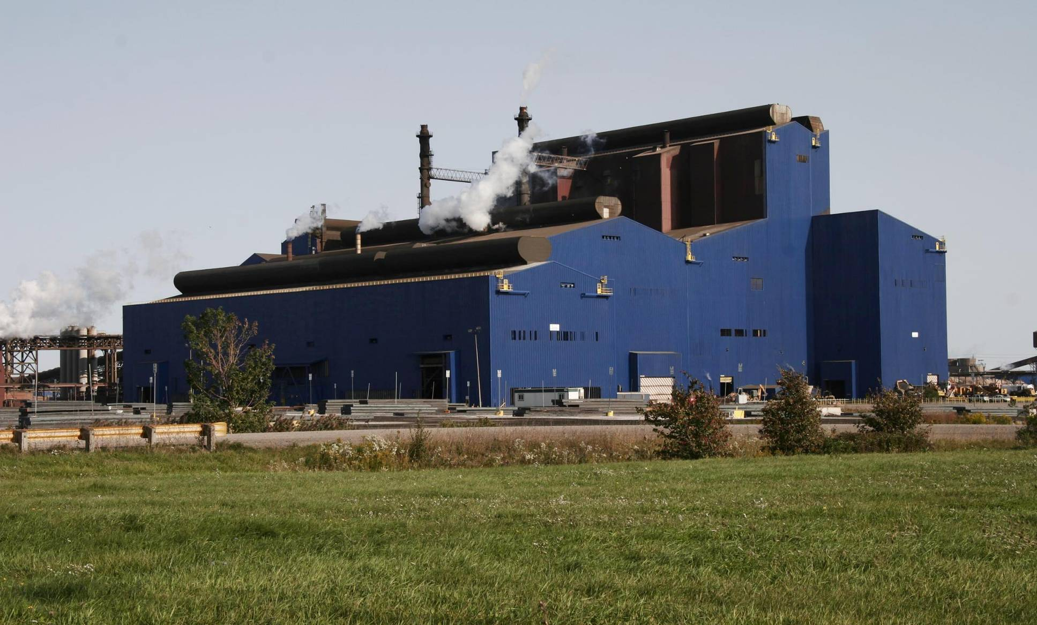
Basic Oxygen Steelmaking Complex
Transfer Ladle Desulphurization with Rotary Lance
2 Top-blown BOF Vessels with a heat size of 275 tons (250 tonnes)
Ladle Trim Station (LTS) and RHOB Vacuum Degassing in secondary steelmaking
Twin strand caster upgraded in 1997

Slide 4
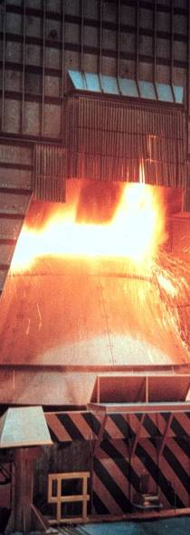
BOF Endpoint Control – Equipment
Top blown only
3-port lances currently in use (previously using 4-port)
Suppressed combustion hoods
Off-gas analysis from both hood and stack
    Recently upgraded analysers from mass spectrometers to linear photometric system (quicker response time, reduced maintenance)
No off-gas temperature measurement
Drop “Bomb” thermocouple system for temperature only or temperature/oxygen measurement
> 90% Direct tap
Aim for sample during tapping on every heat

Slide 5
BOF Endpoint Control – Strategy
Static Charge Model
Currently blow all heats to an aim of 0.045% C
Input weights (Hot metal & Scrap) calibrated minimum every 6 weeks
Drop “Bomb” thermocouple at 90% of blow for temperature only
Operator adjusts based on off-gas measurement
End blow confirmation by temperature-oxygen “bomb” and/or turndown sample

Slide 6
End-of-Blow Off Gas Analysis – Hood

Slide 7
End-of-Blow Off Gas Analysis

Slide 8
Current Work & Future Development
Hood analyzer is quicker than stack by approximately 30-45 sec, but can vary based on gas flow
Hood analyzer typically shows more variability
  Sampling and gas cleaning system
  Impact of bulk gas flow rates on response times
Investigating calibration methods to ensure consistency between hood and stack analyzers (and vessel to vessel)
Upgrading position sensors for lance height determination
Developing dynamic end-point prediction model based on off-gas measurement

